Slide 1
UCPLA DREAM TEAM FINAL PRESENTATION
Hackaday Prize 2020

Slide 2
OUTLINE
Introduction
Deliverable 1: Gesture Control Remote
Deliverable 2: Adaptive Universal Remote

Slide 3
NEEDS ANALYSIS
The UCPLA community is diverse; everyone is unique.
Commercial assistive technology (AT) devices are not tailored for this community.
Expensive
Not adaptable to different users
Limited options
Lack of options prevent CP users from using digital devices.

Slide 4
GOALS
Design AT input devices that are:
Affordable, Portable, Scalable, Customizable, Durable, User-friendly
Project Goals:
Deliverable: Prototype for one application: Roku control (Works out of the box with minimal setup)
Setup to Scale: Scalable strategy for universal control of IoT devices

Slide 5
Gesture Control Remote
Initial Concept
User Testing and Lessons Learned
Continued Prototype Development
Scalability

Slide 6
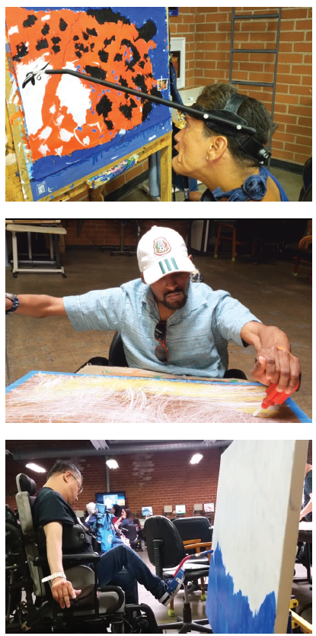
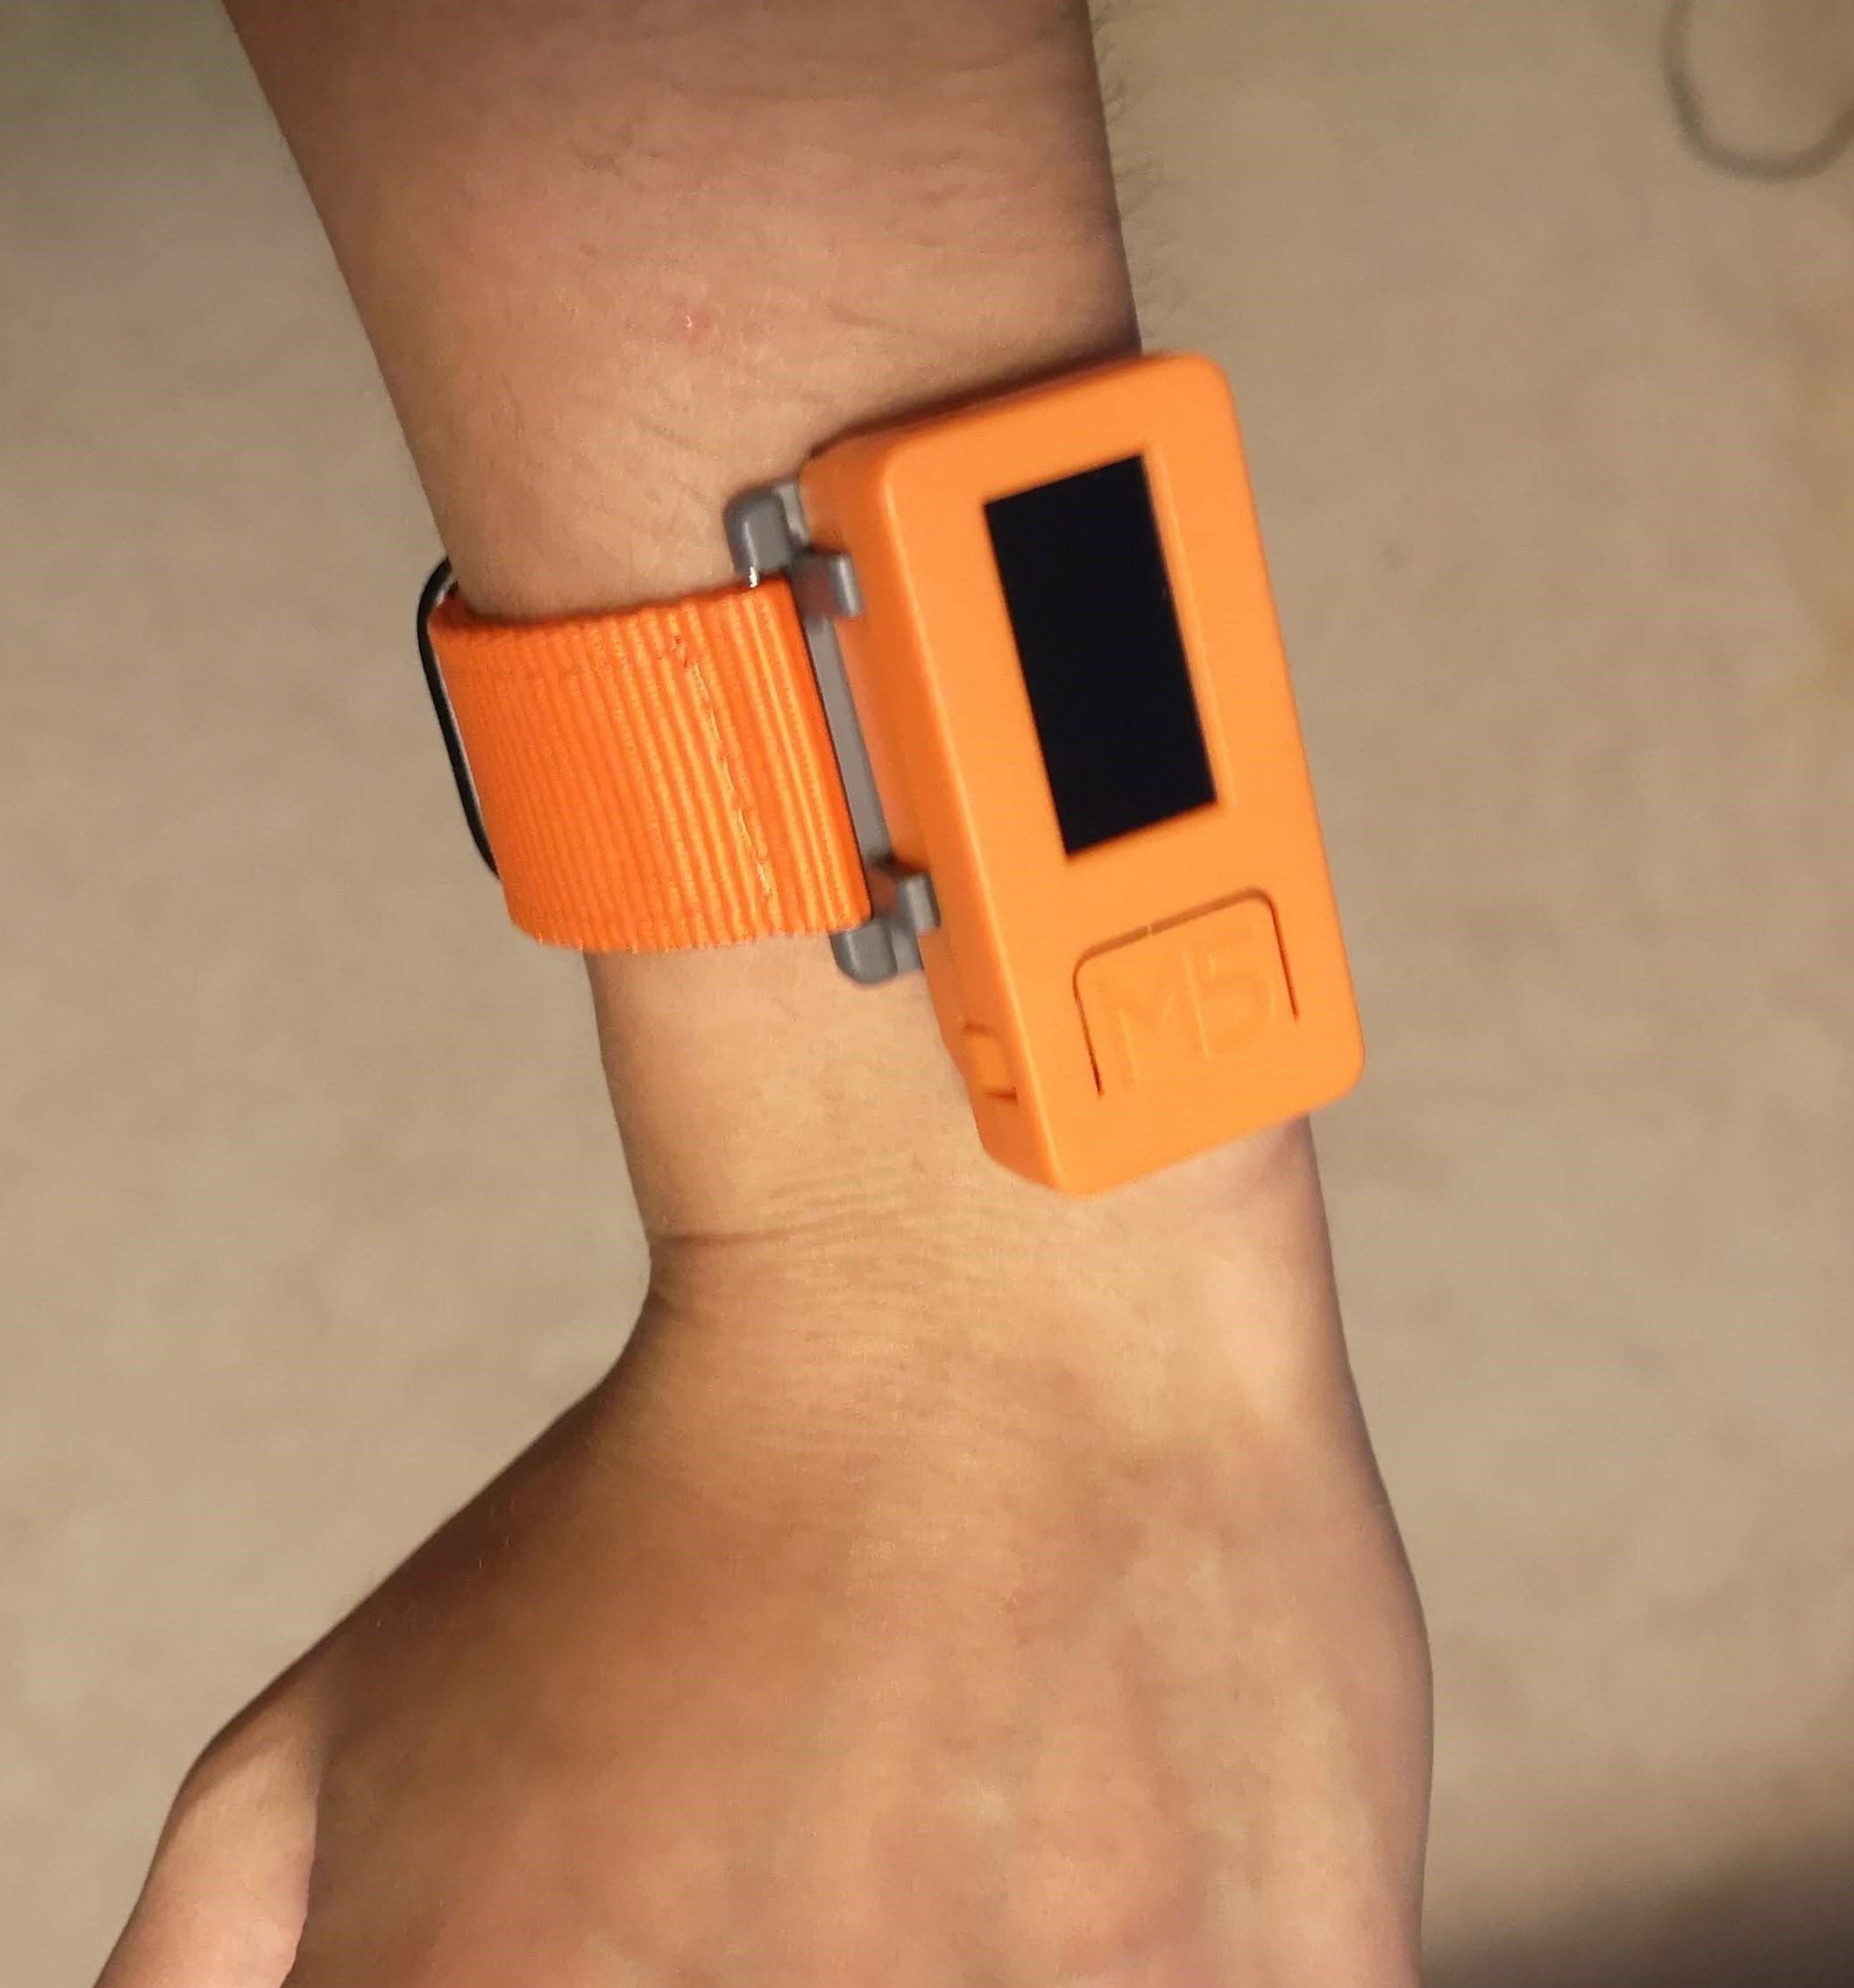
Initial Concept
Inspiration: UCPLA Artists
Initial Proof of Concept: Off-the-shelf device for drawing in MS Paint
Images from UCPLA
Wearable device for emulating a bluetooth mouse
Drawing in MS Paint
Notes:
30 seconds
inspiration from painting
everyone has some motion, whether it be head, hand or foot
can we do the same digitally?
Bluetooth mouse emulation using motion remote controller
Mouse movement and click
Add technical details?
Hardware: 6 axis IMU, ESP32 (IoT microcontroller), battery powered (20 minutes)
Software: Arduino/micropython compatible

Slide 7
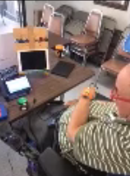
First User Testing Session
Key Takeaways
Learning curve
Muscle memory vs. visual feedback
Utility beyond universal remote
Physical therapy tool
User adoption
One chance to make a first impression
Activities that are fun or allow expression of creativity
CP user testing session playing fish maze game using gesture control.
Images from UCPLA
Notes:
1 minute

Slide 8
Hardware Developments
- Short Term Tasks
Improve battery life (6-8 hours)
Incorporate haptic feedback
Allow user to toggle between devices
3. RAISED BUTTON
2. VIBRATING MOTOR
1. LARGER BATTERY
Device Interior
Device Exterior
Notes:
1 minute

Slide 9
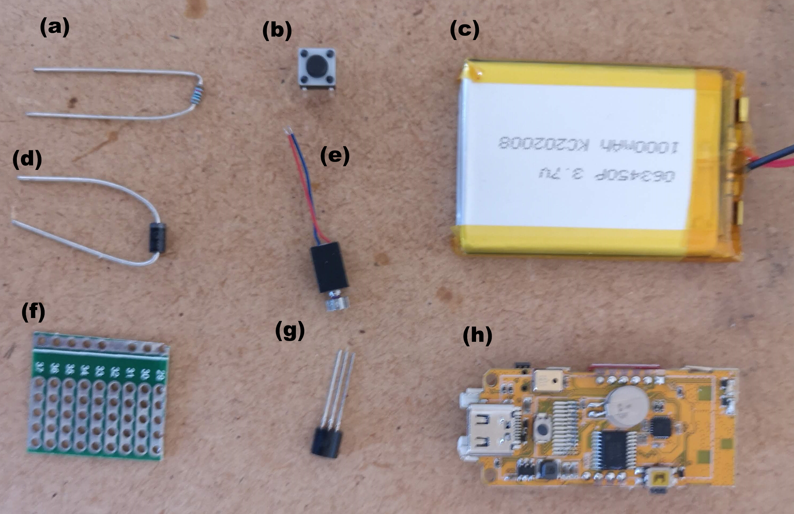
Parts List for Motion Sensing Remote
 | Device/Part | Material Cost
1) | Gesture Control Wearable Remote | $24.40
(a) | 10k Resistor | $0.19
(b) | Tactile Switch | $0.10
(c) | 1 Ah LiPo rechargeable battery | $6.84
(d) | Diode | $0.15
(e) | Vibrating motor | $2.55
(f) | Protoboard | $0.75
(g) | MOSFET | $0.29
(h) | M5StickC dev unit | $12.88
(i) | 6 x M2 Screws | $0.65
2) | Dongle | $9.63
(a) | Atom Matrix dev unit | $9.63
1)
2)
+ Miscellaneous components (3D printed parts, wire, solder, USB cables, etc.)

Slide 10
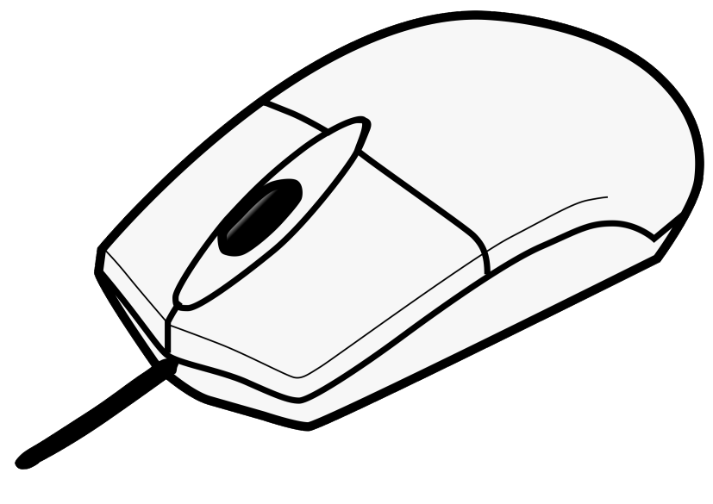
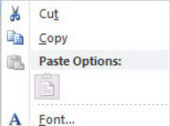
Software Developments
- More Difficult Questions
How do we expand the number of “buttons”?
Mouse Analogy
UP
“Single Click” Functions
LEFT
RIGHT
Single vs Double Click
Right Click Menu
DOWN
IMU Device: 4 positions
Roku Remote: 20 buttons
Notes:
1 minute

Slide 11
Software Developments
- More Difficult Questions
How do we expand the number of “buttons”?
Select OK
UP
“Single Click” Functions
“Double Click” Functions
Left
sub-menu
Right
sub-menu
LEFT
RIGHT
DOWN
Return to main menu
Notes:
1 minute

Slide 12
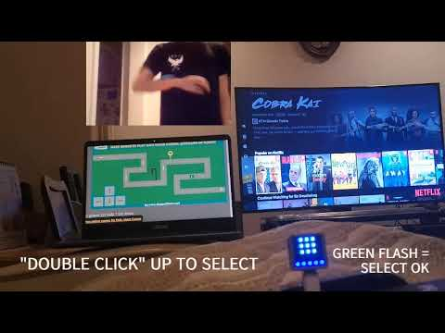
Notes:
2 minutes

Slide 13
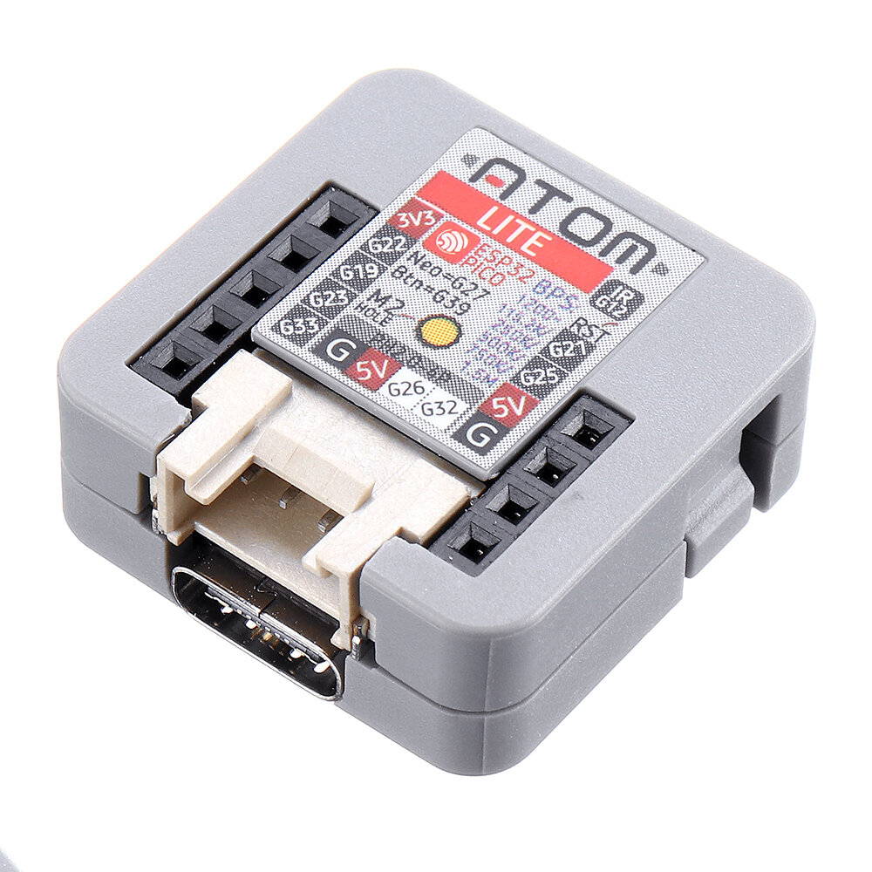
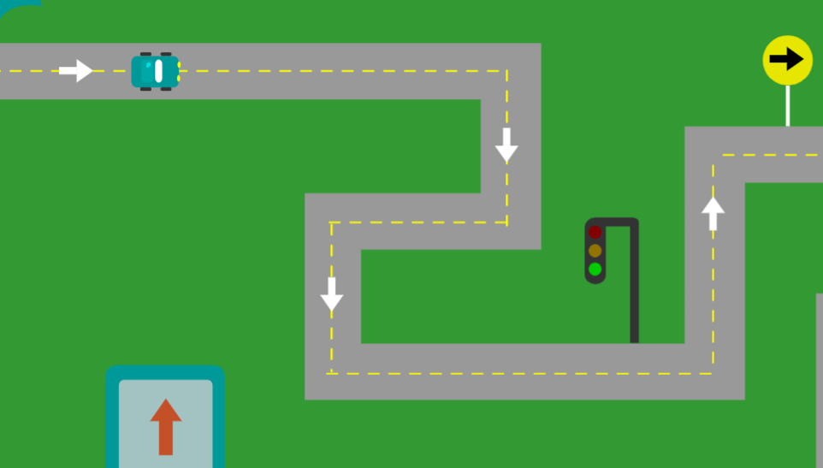
Software Developments
- More Difficult Questions
Scaling: How do we make our devices more “universal” (multi-functional)?
Current Approaches (Single Path)
Gesture Control Remote Computer
Notes:
1 minute

Slide 14
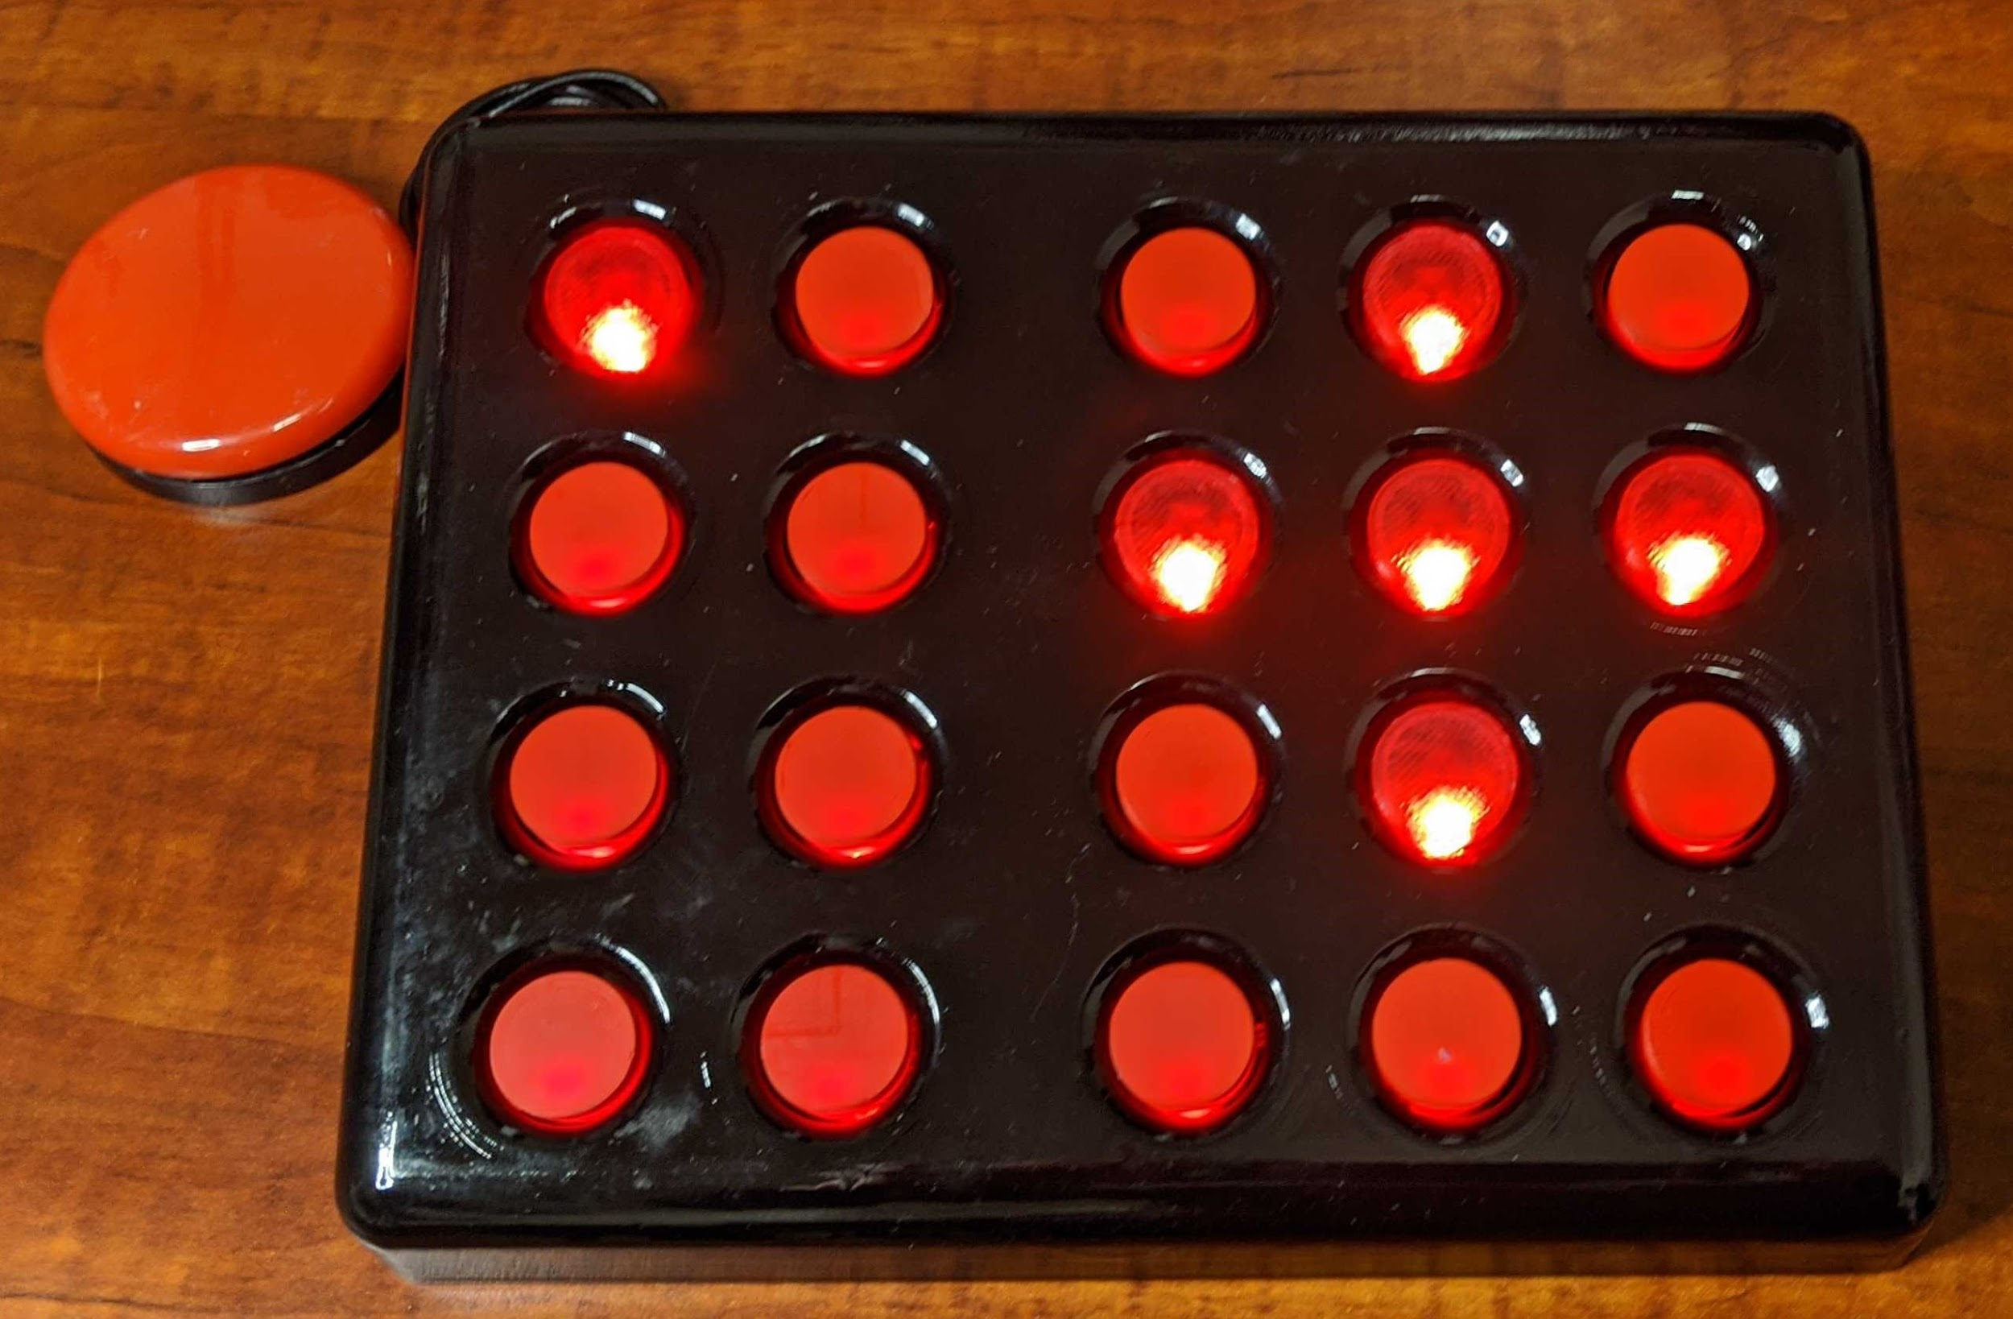
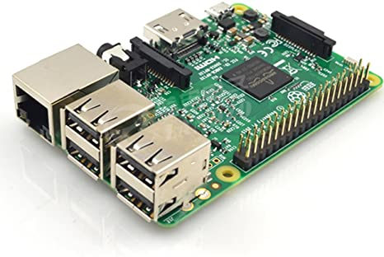
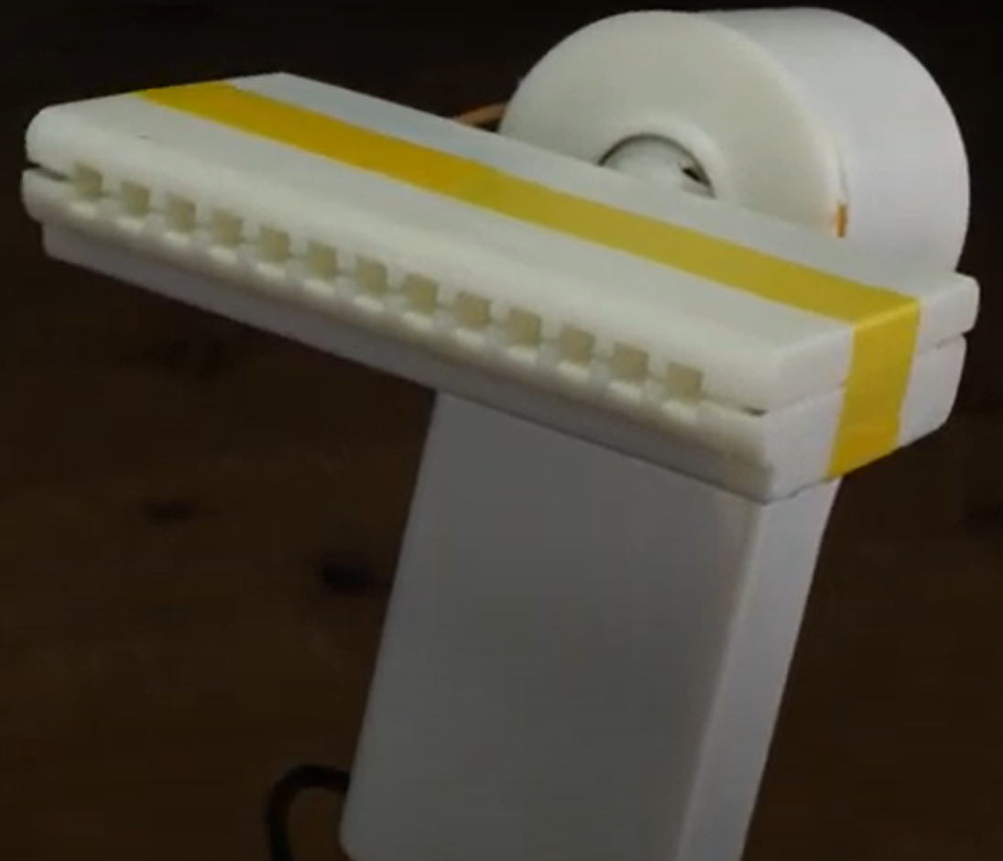
Scaling Operation (and making the project Open Source-Friendly)
Raspberry Pi running HassOS
Motion: IMU Remotes
Digits: Wireless Keyboard
Mouth: Magpie MIDI Hackaday project
One Common Gateway for one Residence (like a router)
User chooses AT Device(s)
Smart Technology

Slide 15
Gesture Control Remote
- Future Developments
Deliver new prototypes
Project documentation and user manuals to be uploaded
Configure system to use Photoshop
User-friendly approaches to installing firmware and adding configurations
Sending emergency notifications

Slide 16
Adaptive Universal Remote
Initial Concept
User Testing and Lessons Learned
Course Correction
Deliverable & Demo

Slide 17
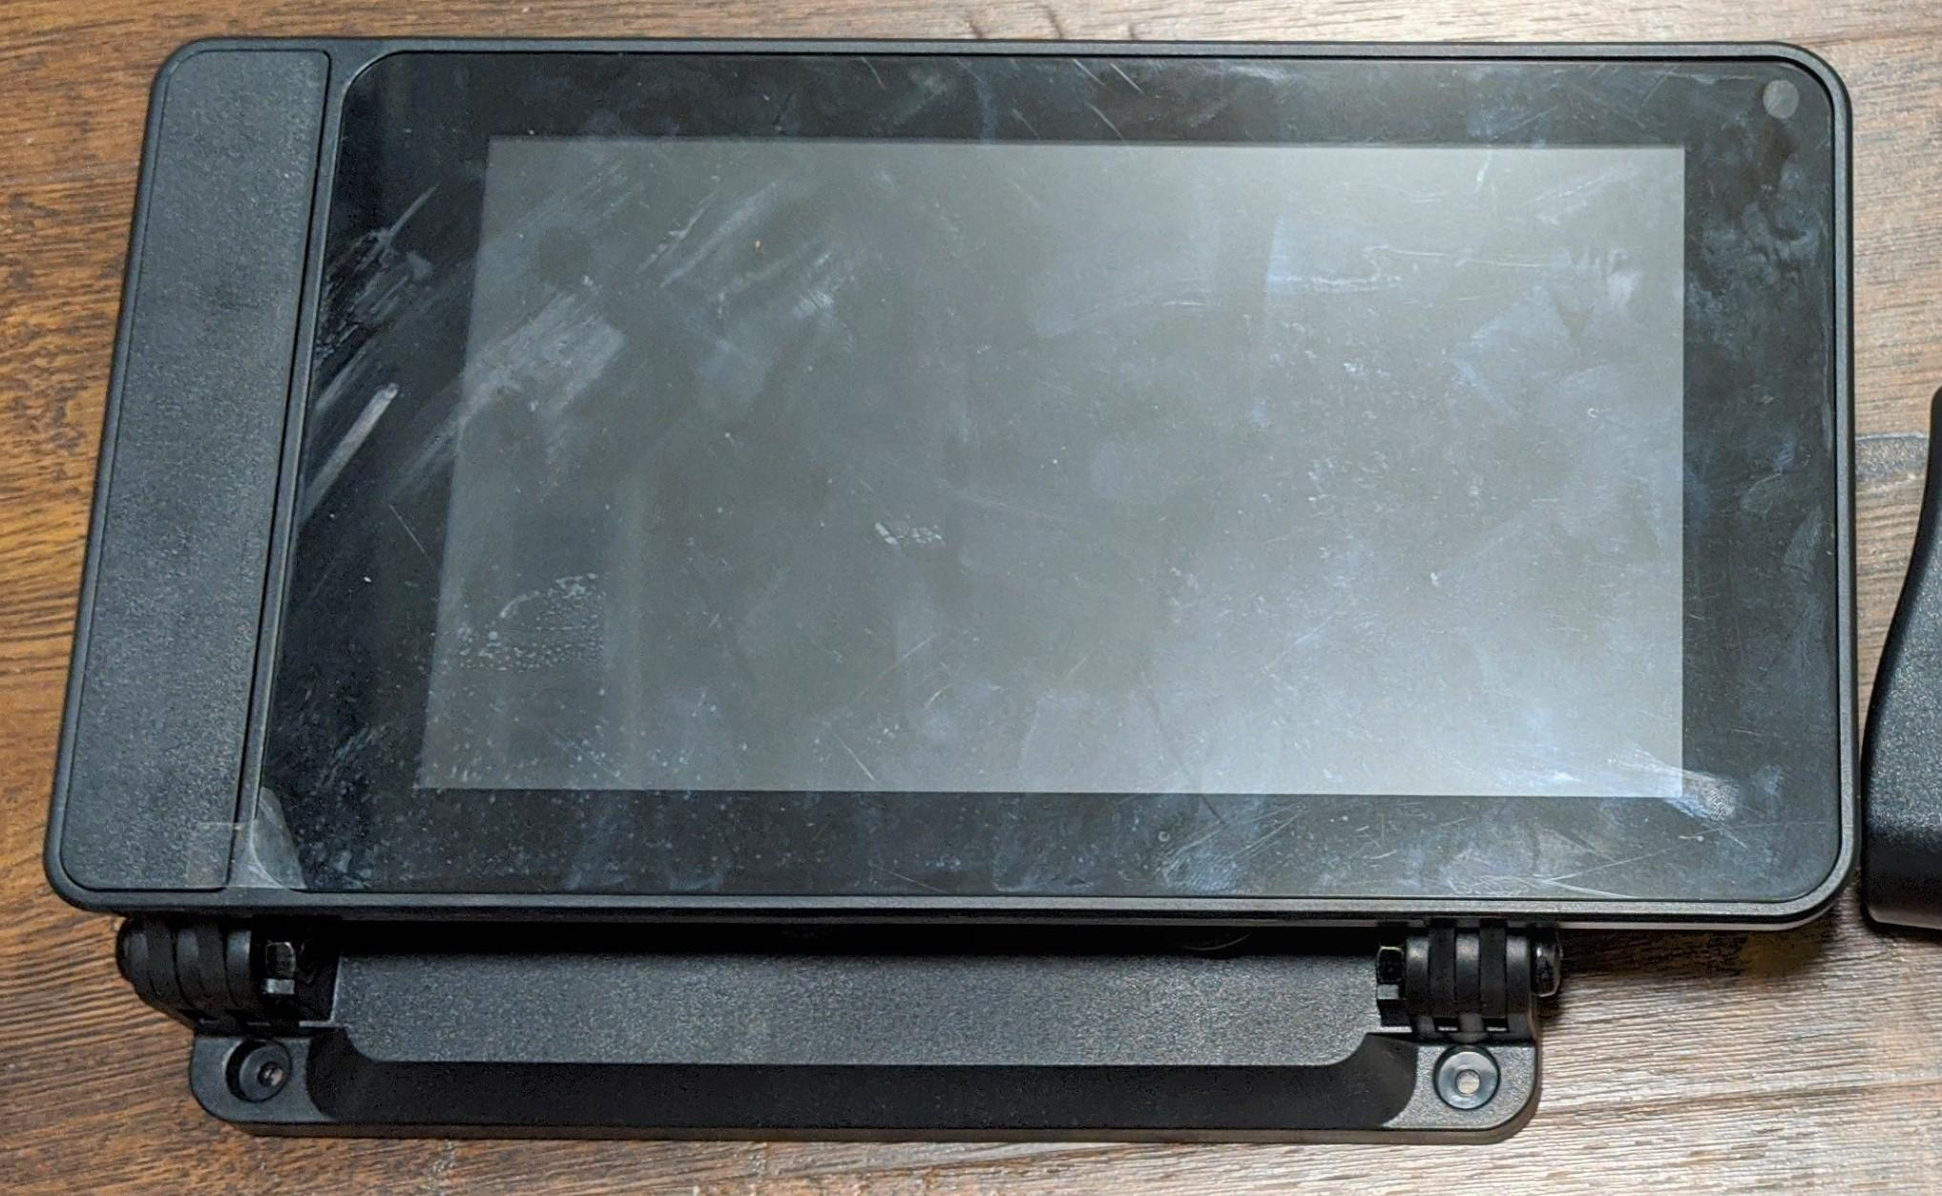
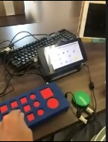
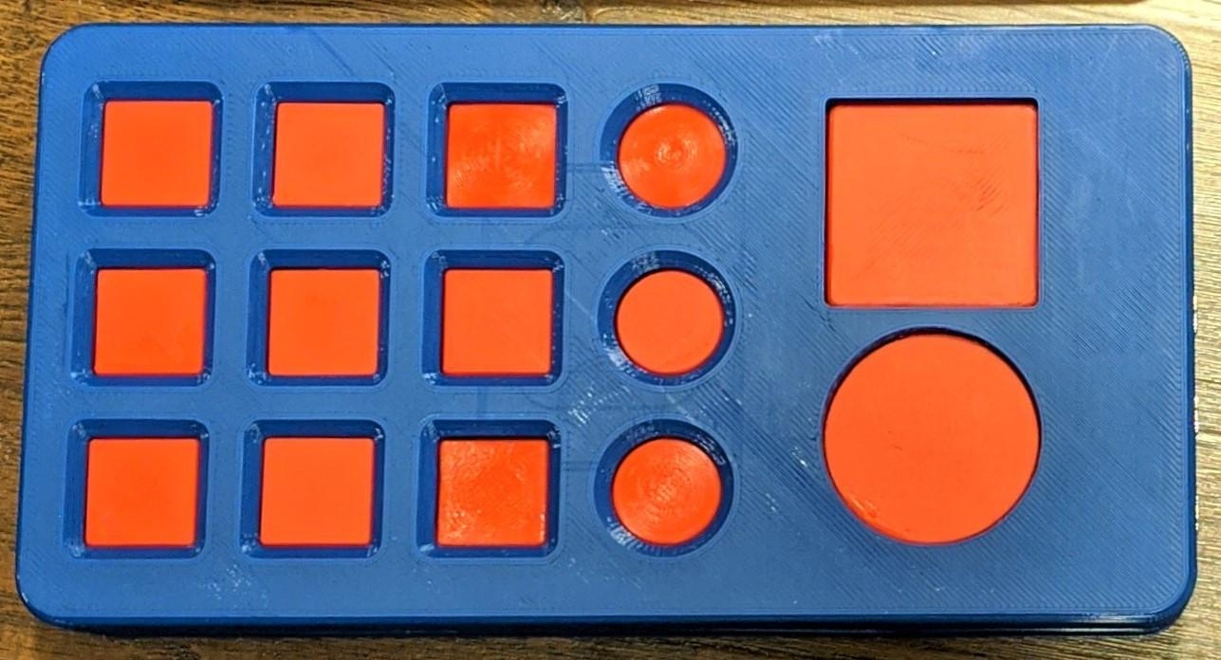
Initial Concept & Lessoned Learned

Slide 18
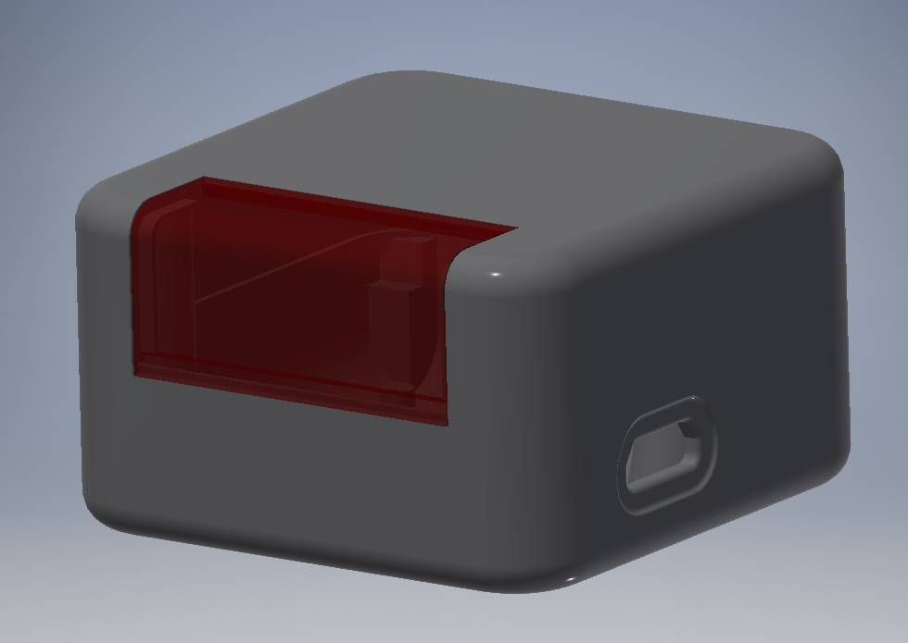
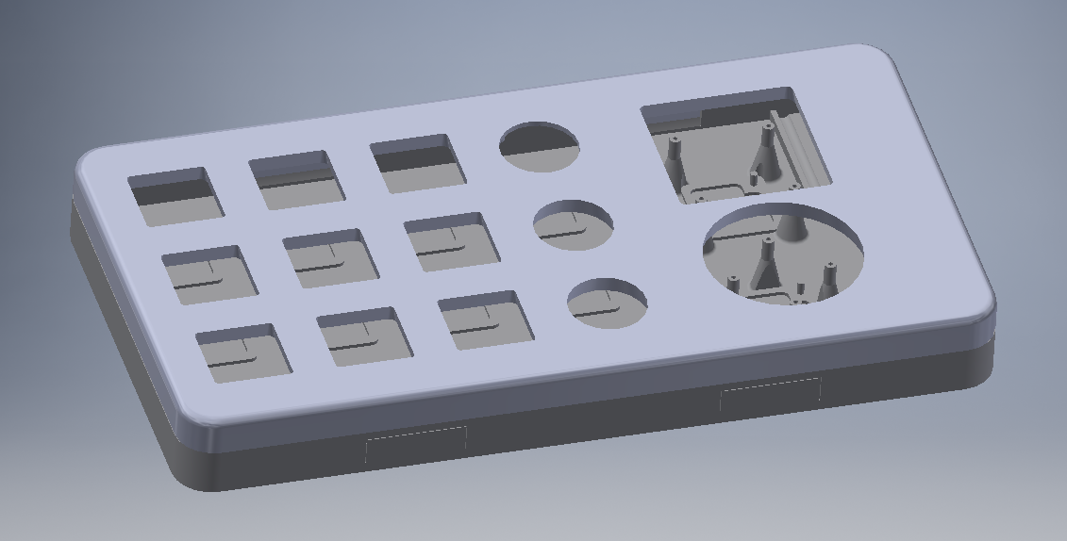
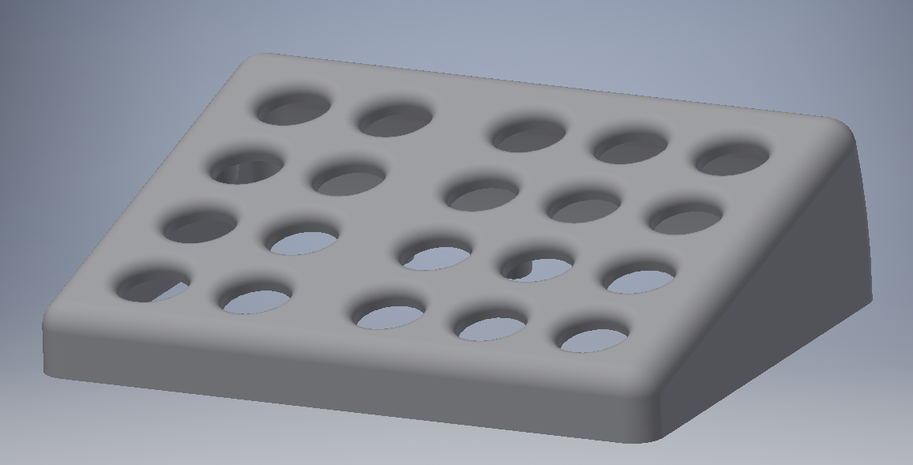
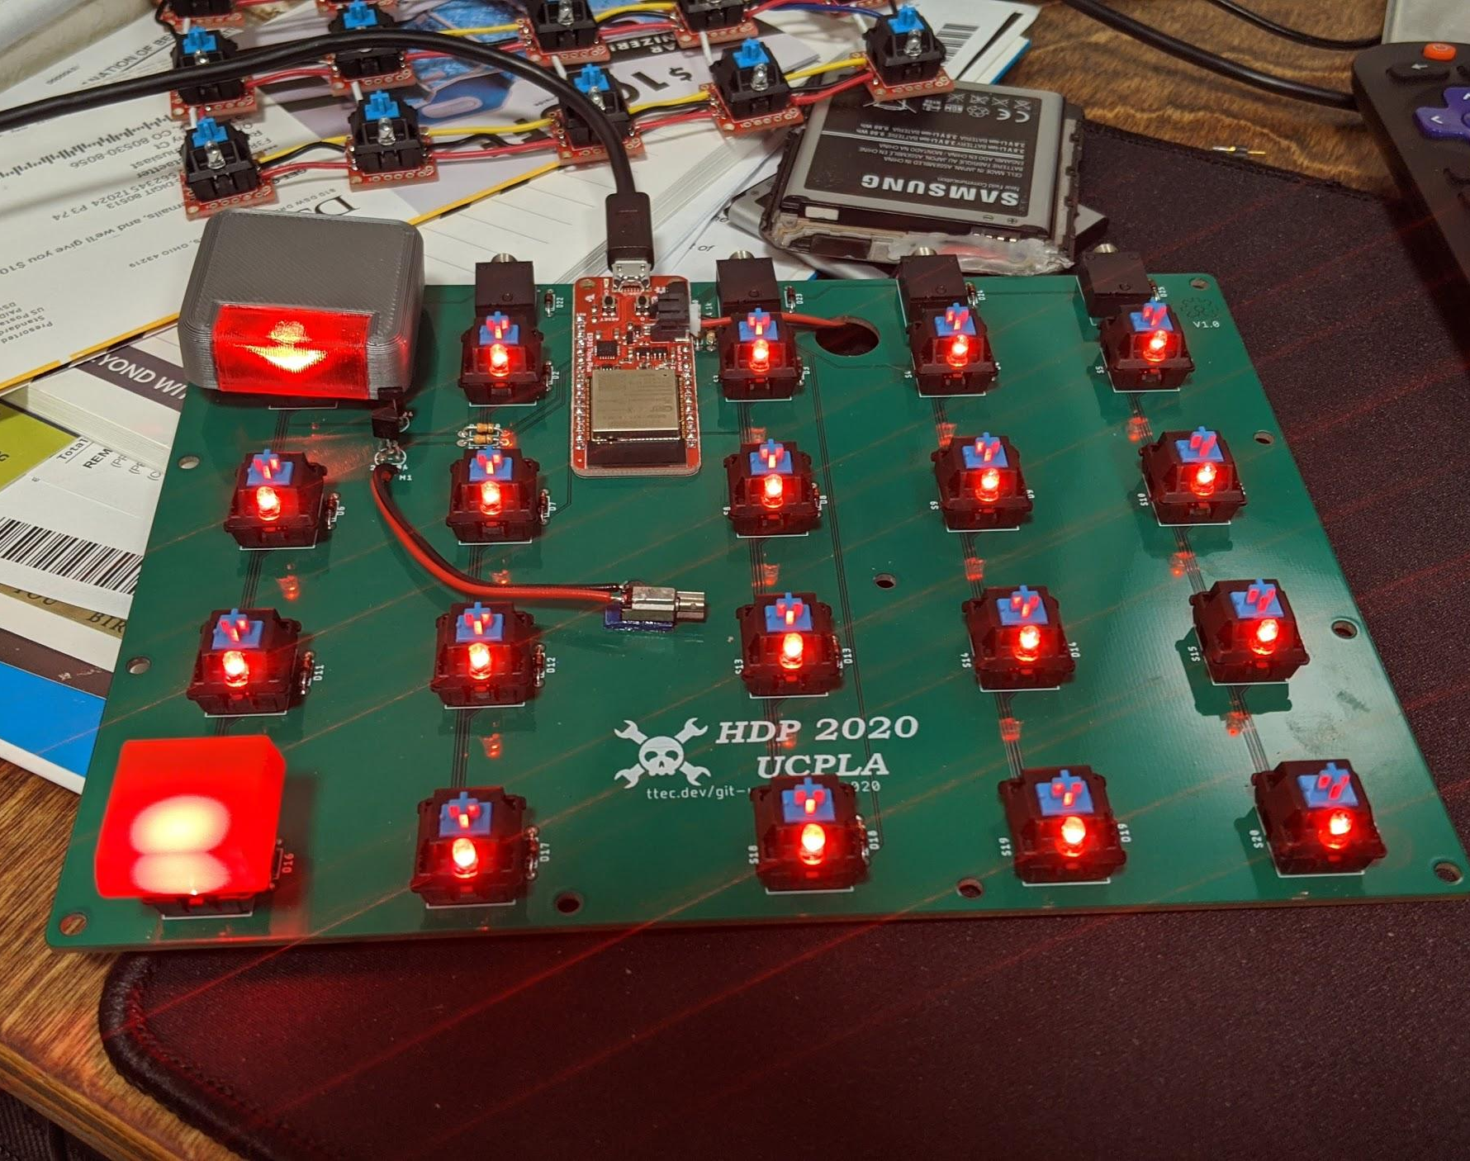
Concept Progression

Slide 19
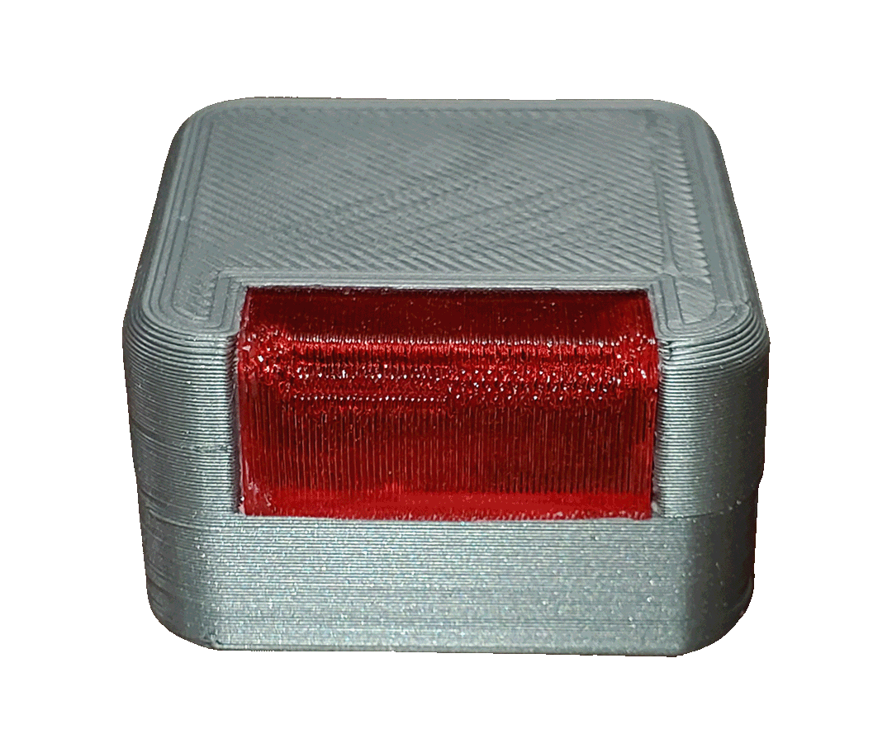
Deliverable & Demo

Slide 20
Thank you for your attention!
Questions, Comments and Feedback

